Slide 1
Introduction to Statistics for Ecology and Evolutionary Biology Interactions Week 12 22 November 2021

Slide 2
Notes:
Emphasize the unity between many common statistical tests and the procedures we’ve learned in this course (implementing these types of analyses as different forms of regression)
https://lindeloev.github.io/tests-as-linear/

Slide 3
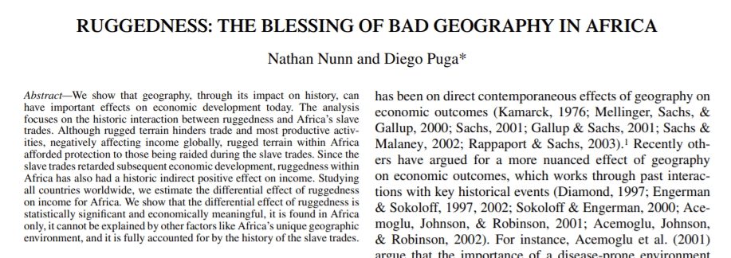
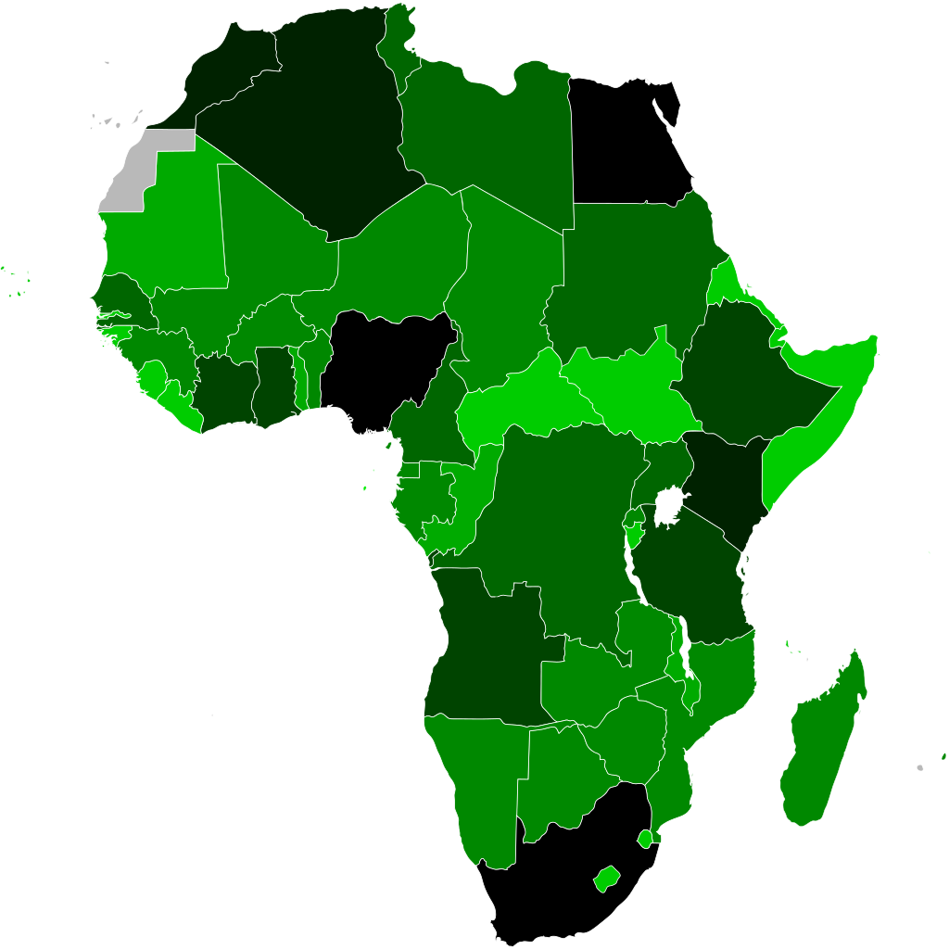
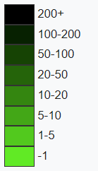
What predicts GDP?
Ruggedness can negatively affect economic development
Ruggedness also protected some countries from slave traders, and salve trade negatively affected subsequent economic development
Notes:
Note that GDP (gross domestic product) is a common economic indicator but also a silly one as it says little about the health of an economy or the distribution of income in the population.

Slide 4
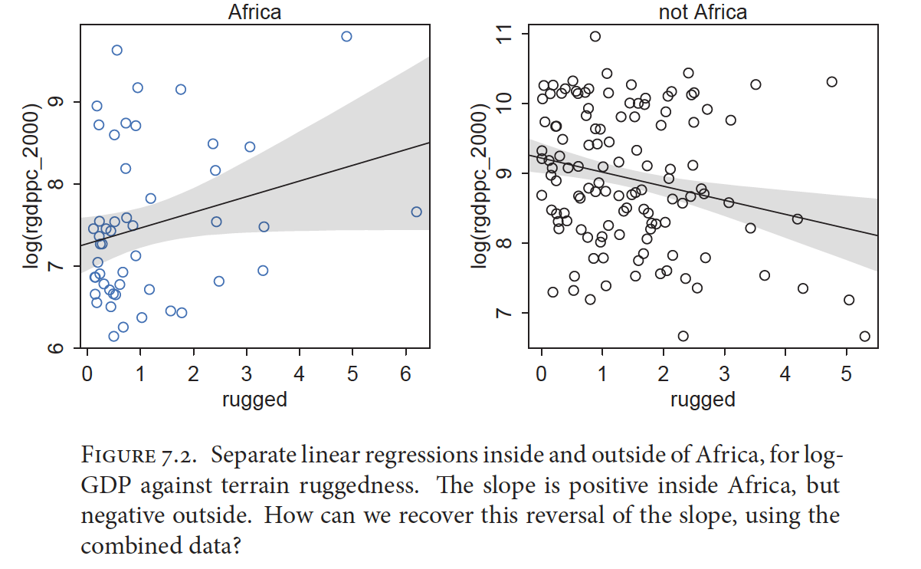
Interactions: What If Predictors Depend Upon Other Predictors?

Slide 5
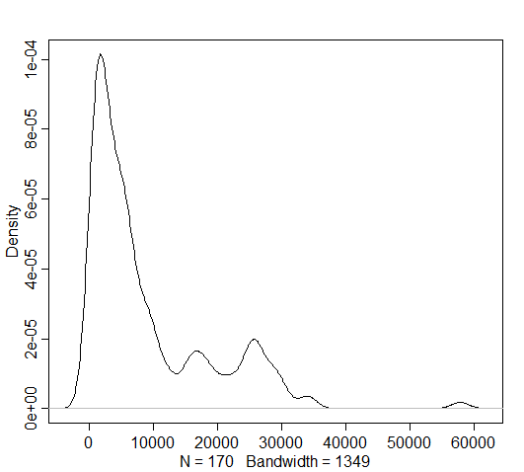
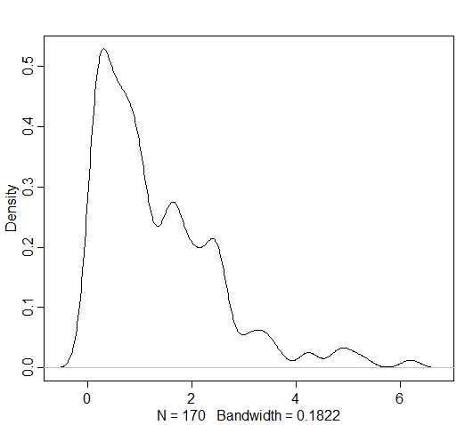
Dataset “rugged”
Rgdppc_2000: Per capita GDP in 2000
Rugged: Magnitude of terrain ruggedness
GDP
ruggedness

Slide 6
Data transformations
Ruggedness:
Value of 0 means flat
Raw values not easily interpreted
Best transformation: Scale to range from 0 – 1 by dividing each value by the maximum
Per capita GDP
Mean is about $9,000 per person
Absolute values aren’t that meaningful
Best transformation: Either standardize so mean is 0 (subtract mean and divide by SD) or scale so values are % of world mean GDP (divide by mean)

Slide 7
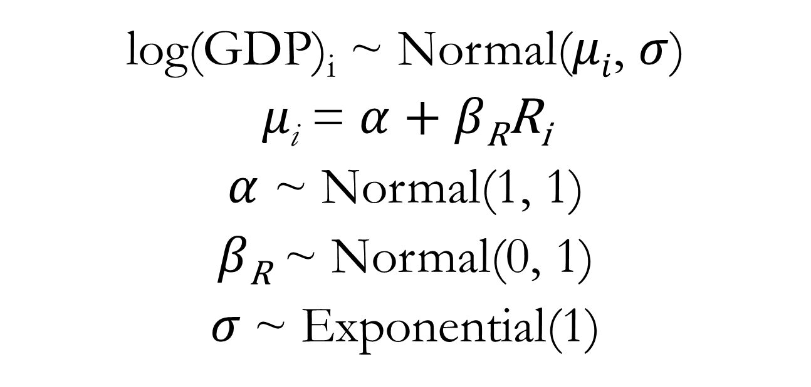
Linear Regression for GDP Predictor: Ruggedness (R)
log(GDP)_{i} ~ Normal($μi$, $σ$)
$μ\text{i}$ = $α$ + $β\text{R}\text{R}\text{i}$
$α$ ~ Normal(1, 1)
$β\text{R}$ ~ Normal(0, 1)
$σ$~ Exponential(1)
See lecture code
Notes:
We use log(GDP) because like other variables we have encountered, GDP tends to increase exponentially with underlying predictors (wealth generates wealth).

Slide 8
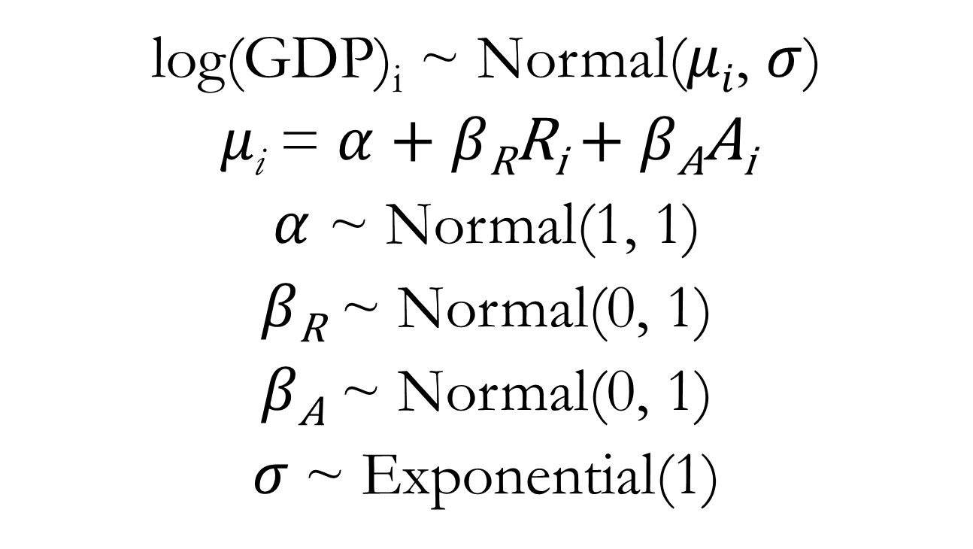
Multiple Regression for GDP Predictors: Ruggedness (R) and Continent Identity (A)
log(GDP)_{i} ~ Normal($μi$, $σ$)
$μ\text{i}$ = $α$ + $β\text{R}\text{R}\text{i}$ + $β\text{A}\text{A}\text{i}$
$α$ ~ Normal(1, 1)
$β\text{R}$ ~ Normal(0, 1)
$β\text{A}$ ~ Normal(0, 1)
$σ$~ Exponential(1)
See lecture code
Notes:
Where Ai is a dummy variable indicating whether or not the country in question is within Africa or not

Slide 9

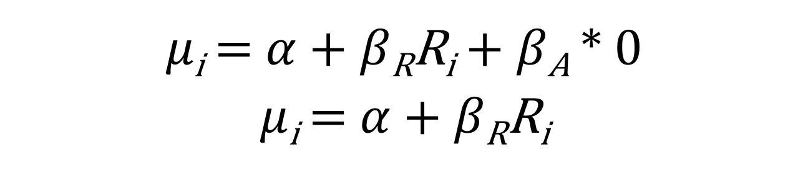
Equation for the Mean GDP
$μ\text{i}$ = $α$ + $β\text{R}\text{R}\text{i}$ + $β\text{A}A\text{i}$
Outside of Africa: A_{i} = 0
$μ\text{i}$ = $α$ + $β\text{R}\text{R}\text{i}$ + $β\text{A}$ * 0
$μ\text{i}$ = $α$ + $β\text{R}\text{R}\text{i}$

Slide 10

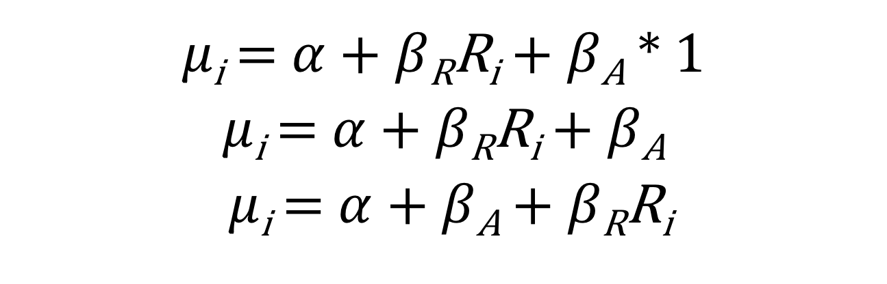
Equation for the Mean GDP
$μ\text{i}$ = $α$ + $β\text{R}\text{R}\text{i}$ + $β\text{A}A\text{i}$
In Africa: A_{i} = 1
$μ\text{i}$ = $α$ + $β\text{R}\text{R}\text{i}$ + $β\text{A}$ * 1
$μ\text{i}$ = $α$ + $β\text{R}\text{R}\text{i}$ + $β\text{A}$
$μ\text{i}$ = $α$ + $β\text{A}$ + $β\text{R}\text{R}\text{i}$

Slide 11
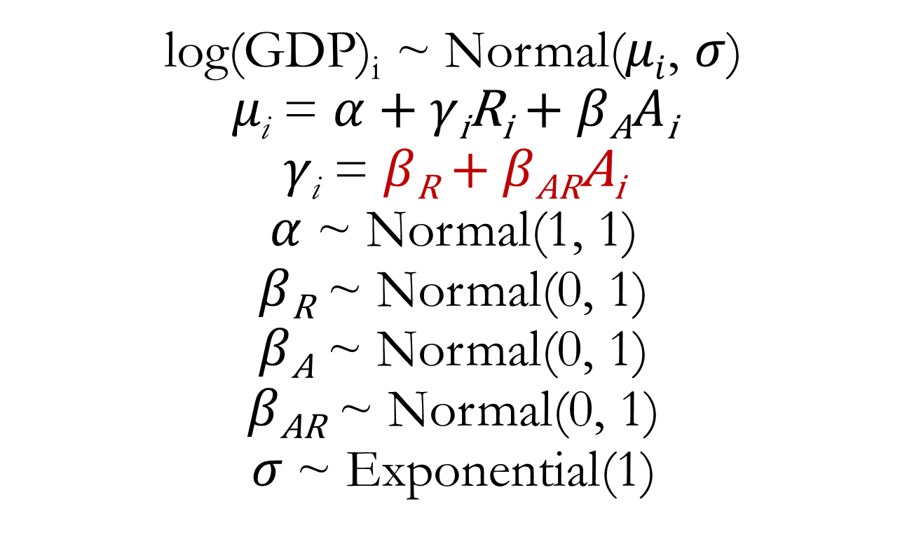
Multiple Regression for GDP Predictors: Ruggedness, Continent Identity, and Interaction
log(GDP)_{i} ~ Normal($μi$, $σ$)
$μ\text{i}$ = $α$ + $γ\text{i}\text{R}\text{i}$ + $β\text{A}A\text{i}$
$γ\text{i}$ = $β\text{R}$ + $β\text{A}\text{R}\text{A}\text{i}$
$α$ ~ Normal(1, 1)
$β\text{R}$ ~ Normal(0, 1)
$β\text{A}$ ~ Normal(0, 1)
$β\text{A}\text{R}$ ~ Normal(0, 1)
$σ$~ Exponential(1)

Slide 12
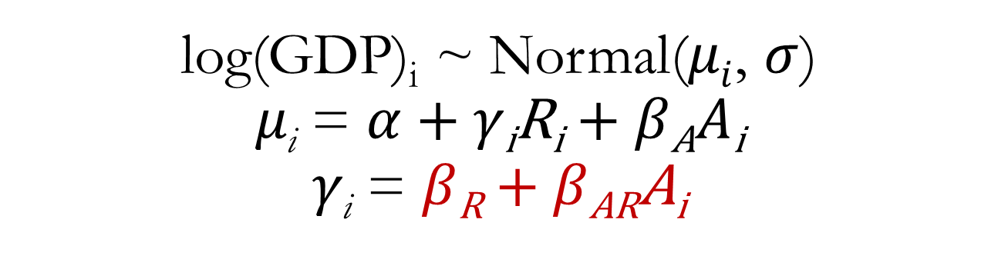
Multiple Regression for GDP Predictors: Ruggedness, Continent Identity, and Interaction
log(GDP)_{i} ~ Normal($μi$, $σ$)
$μ\text{i}$ = $α$ + $γ\text{i}\text{R}\text{i}$ + $β\text{A}A\text{i}$
$γ\text{i}$ = $β\text{R}$ + $β\text{A}\text{R}\text{A}\text{i}$
The slope coefficient, that is, the association between GDP and ruggedness, is itself a linear function with one predictor, A (our index variable for Africa)

Slide 13
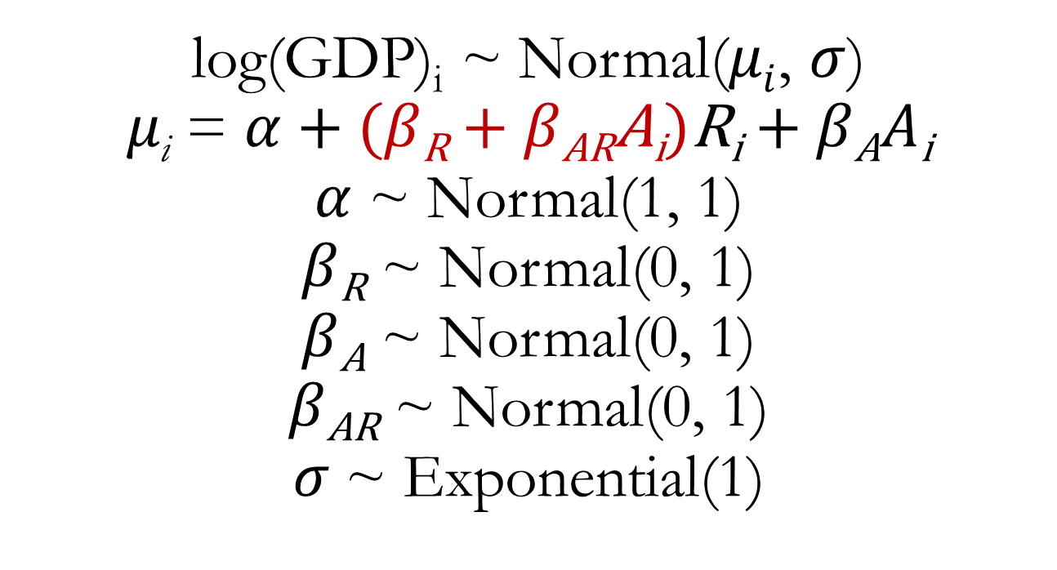
Plug equation for gamma into equation for mean GDP
log(GDP)_{i} ~ Normal($μi$, $σ$)
$μ\text{i}$ = $α$ + ($β\text{R}$ + $β\text{AR}\text{A}\text{i}$)$\text{R}\text{i}$ + $β\text{A}A\text{i}$
$α$ ~ Normal(1, 1)
$β\text{R}$ ~ Normal(0, 1)
$β\text{A}$ ~ Normal(0, 1)
$β\text{A}\text{R}$ ~ Normal(0, 1)
$σ$~ Exponential(1)

Slide 14
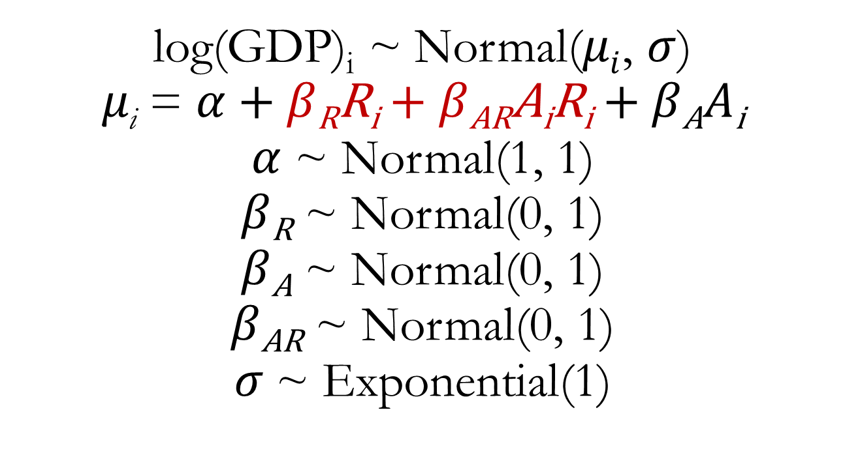
Apply some algebra distributive rule: m(a + b) = ma + mb
log(GDP)_{i} ~ Normal($μi$, $σ$)
$μ\text{i}$ = $α$ + $β\text{R}\text{R}\text{i}$ + $β\text{AR}\text{A}\text{i}\text{R}\text{i}$ + $β\text{A}A\text{i}$
$α$ ~ Normal(1, 1)
$β\text{R}$ ~ Normal(0, 1)
$β\text{A}$ ~ Normal(0, 1)
$β\text{A}\text{R}$ ~ Normal(0, 1)
$σ$~ Exponential(1)

Slide 15
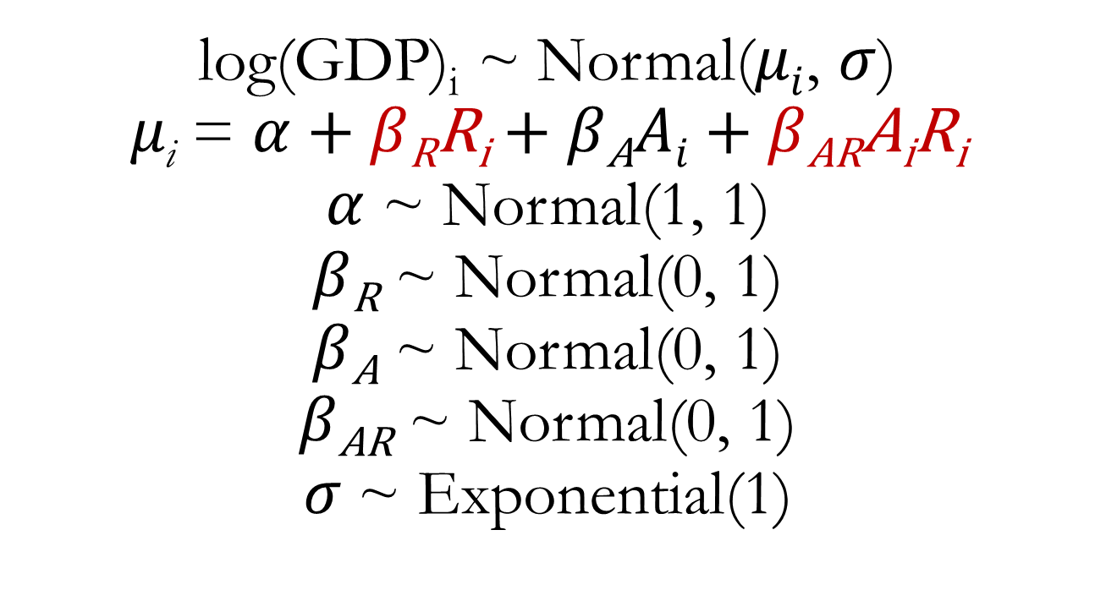
Rearrange
log(GDP)_{i} ~ Normal($μi$, $σ$)
$μ\text{i}$ = $α$ + $β\text{R}\text{R}\text{i}$ + $β\text{A}Ai$ + $β\text{AR}\text{A}\text{i}\text{R}\text{i}$
$α$ ~ Normal(1, 1)
$β\text{R}$ ~ Normal(0, 1)
$β\text{A}$ ~ Normal(0, 1)
$β\text{A}\text{R}$ ~ Normal(0, 1)
$σ$~ Exponential(1)

Slide 16
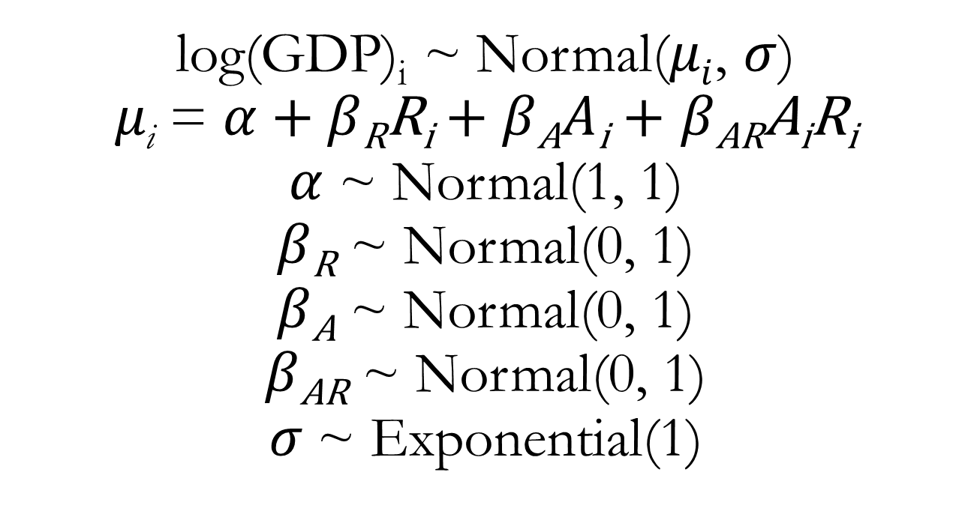
Multiple Regression for GDP Predictors: Ruggedness, Continent Identity, and Interaction
log(GDP)_{i} ~ Normal($μi$, $σ$)
$μ\text{i}$ = $α$ + $β\text{R}\text{R}\text{i}$ + $β\text{A}A\text{i}$ + $β\text{AR}\text{A}\text{i}\text{R}\text{i}$
$α$ ~ Normal(1, 1)
$β\text{R}$ ~ Normal(0, 1)
$β\text{A}$ ~ Normal(0, 1)
$β\text{A}\text{R}$ ~ Normal(0, 1)
$σ$~ Exponential(1)
Dummy variable coding for A

Slide 17
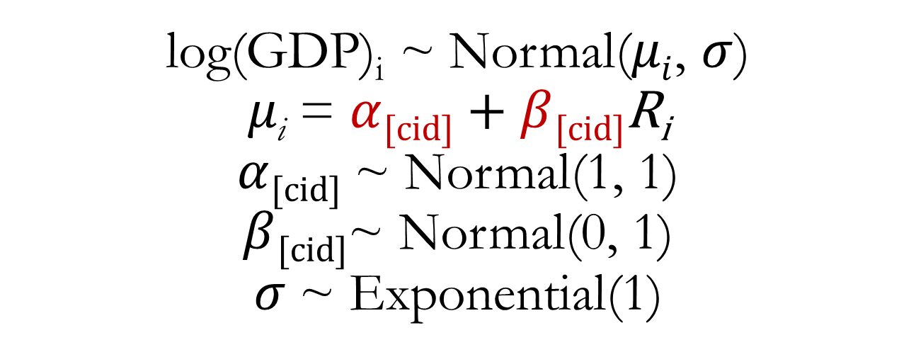
Multiple Regression for GDP Predictors: Ruggedness, Continent Identity, and Interaction
log(GDP)_{i} ~ Normal($μi$, $σ$)
$μ\text{i}$ = $α$_{[cid]} + $β$_{[cid]}$\text{R}\text{i}$
$α$_{[cid]} ~ Normal(1, 1)
$β$_{[cid]}~ Normal(0, 1)
$σ$~ Exponential(1)
Index variable coding for A
Both the intercept and slope are modelled separately for each level of the index variable.
See lecture code

Slide 18
Interaction between continuous predictor variables
Cannot easily be interpreted without plotting
Process:
Bin continuous variable 1 values into 2-4 groups
Create counterfactual plots to evaluate effect of variable 2 on outcome, while holding variable 1 constant
One plot per binned level of variable 1
Plot either 20-50 regression lines from posterior or mean posterior estimate with percentile interval
Examine whether strength or direction of relationship changes across levels of variable 1

